Slide 1

GOOGLE PLAY STORE APPS
REPORT
BY
Neel Balar
20th July, 2023

Slide 2

OVERVIEW
Parental This Data Analysis is for getting insights about the mobile apps with respect to its future business approaches and development of mobile apps. This study has been summarized from the historical data available from the Google Play store from June 2012 till February 2019. It also helps to know the trend involved in the categories of mobile app availability, usability, and users' expectation.
This dataset contains information such as names of the mob apps from the Google Play store, categories, Android versions, Rating, Number of reviews, Number of installs, size of the app, when was last updated, and the current version of the mob apps.
“If you want to achieve greatness stop asking for permissions.”

Slide 3

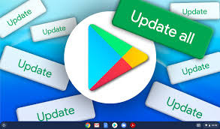
METHODOLOGY
Understand the data.
Clean the data.
Organize the data
Data analysis.
Conclusion.

Slide 4

GOALS
Identify problem background.
Determine most used Android version.
Determine categories of mobile apps are existing from this dataset.
Determine installed category of mobile app.
Find applications which have 5-star ratings.
Find top 10 mobile apps based on ratings.

Slide 5

KPIs
Application Name and Category.
Rating, Size and Installations of an application.
Type and Price of an application.
Content rating and genre of an application.
Android version and last update date of an application.

Slide 6

SUM, AVERAGE, ROUND, COUNT,VLOOKUP, TEXT, IF formulas
Formatting, Sorting.
Pivot Tables
Charts
Concepts Used

Slide 7

ANALYSIS
“The core advantage of data is that it tells you something about the world that you didn’t know before.”

Slide 8
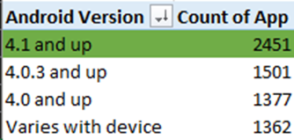
Which is the most used Android version?
The Most used Android version is 4.1 and up.

Slide 9
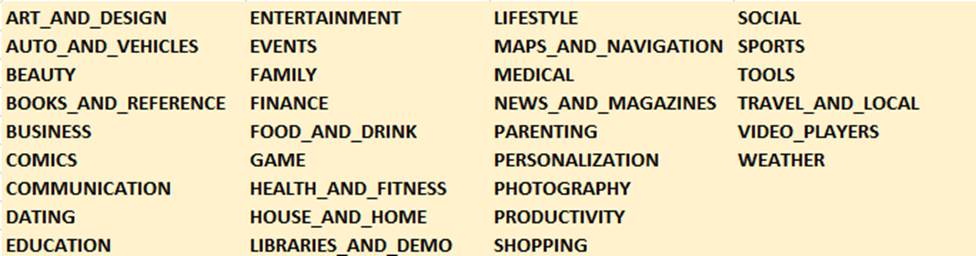
Which all categories of mob apps are existing from this dataset?
These all categories of mobile apps are existing from this dataset.

Slide 10
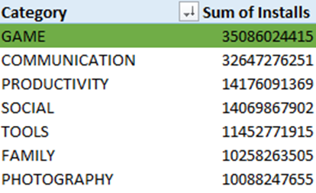
Which is the most installed category of mob app from this dataset?
Most installed category of mobile app is “GAME”.

Slide 11
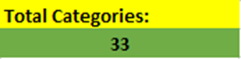
How many total categories are there?
Total 33 categories of applications are there.

Slide 12
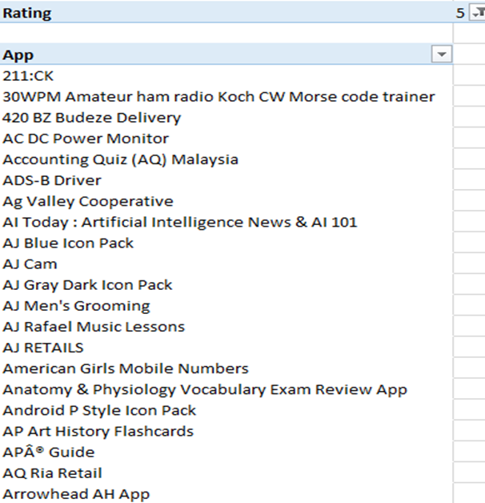
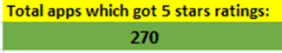
Which apps have got 5-star ratings?
Total 270 applications are there with 5-star ratings.

Slide 13
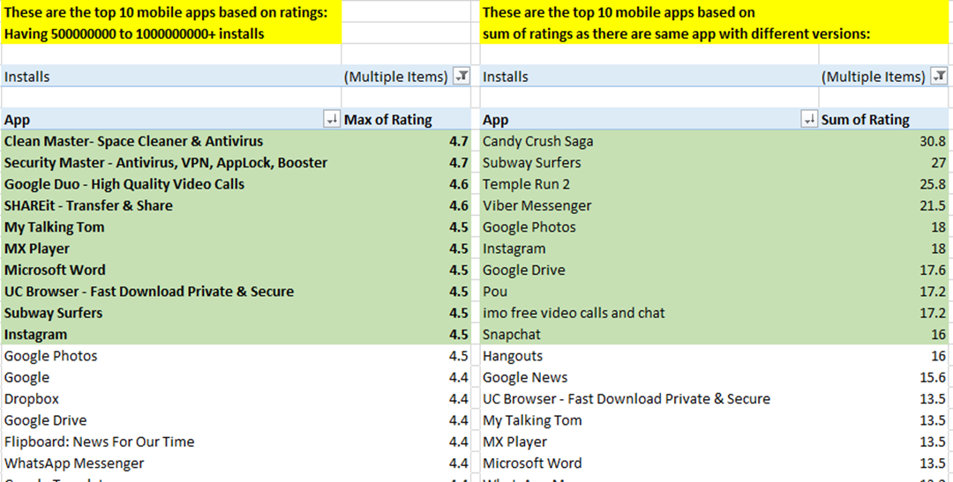
Which are the top 10 mob apps based on ratings?
These apps have best ratings on basis of their installations and all the available versions on play store.

Slide 14

CONCLUSION
This project's main goal is to make the calculation and understanding of the results simpler. The project aims to create a clear and accurate analysis of the dataset. In conclusion, the Play Store application data analysis would have provided valuable insights into various aspects of app performance and user behavior. These conclusions can help developers make informed decisions, improve their apps, and create a better experience for users in the highly competitive app market.

Slide 15



THANK YOU

